Slide 1




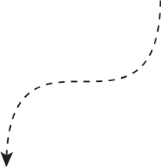
Data Visualization Early Internship
By Team 4

Slide 2














Members Of The Group
Haileloul T. D
Gandla Srujan
Dharuvkumar Bhansali
Elijah M. Flomo
Ranjeet Kumar pal
Team Member
Team Member
Project Lead
Team Member
Team Member
Nandan K
Team Leader
23-09-2025

Slide 3

Work Flow
Week 1
Week 2
Data Cleaning
Dashboard Creation
Objectives and
Context of data
Causes and Insights on the data visualization

Slide 4

Week 1
Data Cleaning
Data Collection
Gathered three raw datasets: Outreach Data, Campaign Data, and Applicant Data.
2. Initial Data Inspection
Audited datasets for structure, data types, missing values, and duplicates.
Examined key columns like dates, phone numbers, application IDs, and remarks.
3. Cleaning of each dataset
Outreach Data
Missing Values: Notable missing data in the free-text "Remark" column (33,804 missing entries).
Duplicates: 446 duplicate entire rows originally, removed completely (0 remaining after cleaning).
Campaign Data
Missing Values: None detected originally.
Duplicates: None originally or after cleaning.
Data Types: "Start_Date" stored as text originally; converted to Date format where
possible. IDs kept as text strings for integrity.

Slide 5

Applicant Data
• Missing Values: One missing entry in "App_ID" removed as it could not be recovered
reliably.
• Duplicates: 16,489 duplicate rows removed fully.
Objective & Context
This analysis was conducted to improve Excelerate’s enrolment outcomes by leveraging data-driven insights from recruitment outreach and applicant data. The primary business goal is to optimize recruitment strategies to increase application rates, enhance candidate engagement, and ultimately improve the quality and quantity of successful enrolments.
By analyzing historical outreach efforts, application patterns, and candidate demographics, this project aims to identify key trends, bottlenecks, and high-impact factors that influence recruitment success. These insights will enable Excelerate to refine outreach timing, prioritize channels, and personalize engagement, thereby gaining a
competitive edge in talent acquisition.

Slide 6
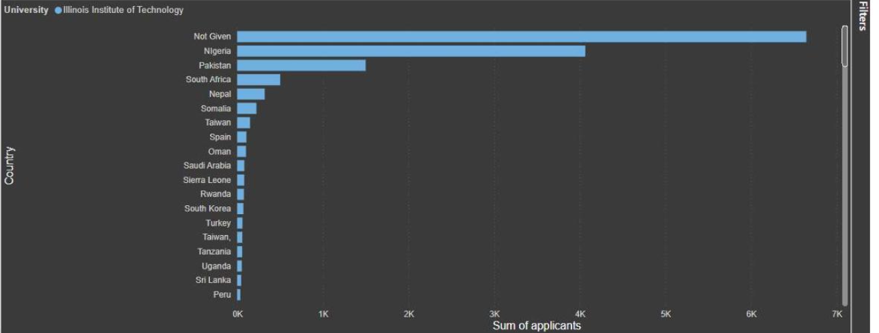
Week 2
Dashboard Creation
The below chart visualizes where most applicants are coming from, segmented by country and specifically for Illinois Institute of Technology as the representative university. It helps identify geographic hotspots and gaps in applicant origins, supporting strategic decisions about international outreach and university partnerships.
Applications by Countries and Universities

Slide 7
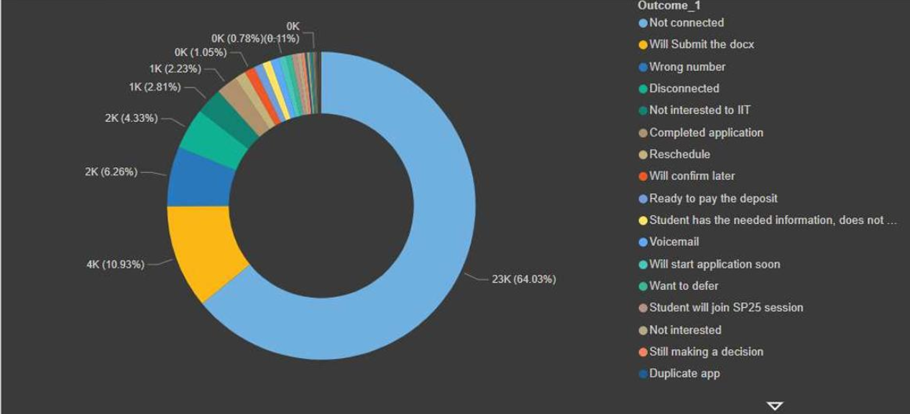
Insights from the above graph
1. Geographic Concentration: The majority of applications come from a few top
entries—“Not Given” (missing country data), Nigeria, and Pakistan—implying these
regions are particularly active or targeted by recruitment efforts.
2. Potential Data Gaps: A significant number of applicants are listed as “Not Given” for
country, highlighting a need to improve data collection for more accurate geographic
analysis and future campaign targeting.
Second graph
Count by outcomes

Slide 8
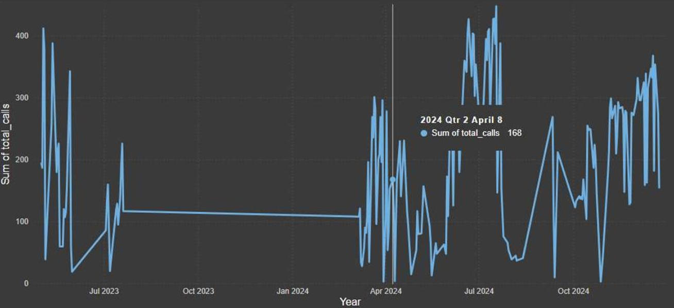
Purpose: To categorize and quantify call outcomes, helping visualize how candidates responded to outreach efforts and what proportion moved through various engagement stages.
Insights from the above graphs
1. Majority Not Connected: The largest segment (23K, 64.03%) indicates most calls were “Not connected,” highlighting a significant challenge in reaching candidates and an area needing focused improvement.
2. Engaged Outcomes: Other notable segments include “Will Submit the docx” (4K, 10.93%), “Wrong number” (2K, 6.26%), “Disconnected” (2K, 4.33%), and “Completed application,” showing that while engagement is achieved with a subset, issues like outdated contacts and candidate drop-off remain substantial barriers.
Third graph
Calls in a year

Slide 9
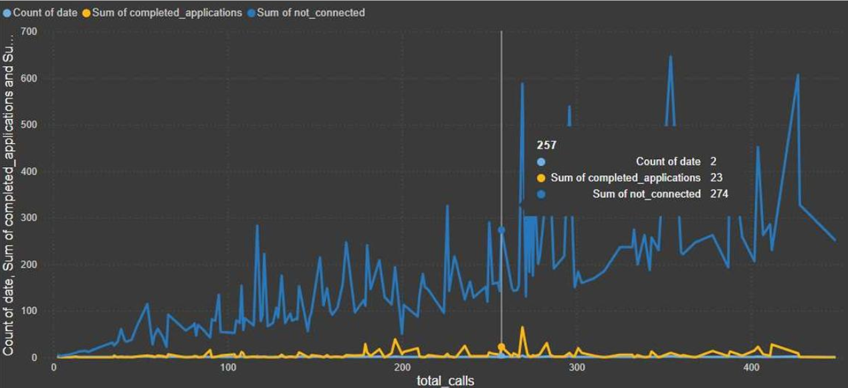
Purpose: This visualization displays the sum of total outreach calls made, broken down by year, quarter, month, and day. Its main purpose is to reveal time-based patterns and trends in outreach activity, allowing stakeholders to understand the volume and timing of recruitment campaigns, detect seasonality, and track shifts in engagement efforts throughout the analyzed period.
Insights from the above graphs
1. Campaign Peaks and Seasonality: The chart shows pronounced peaks at certain periods, suggesting intensive outreach campaigns are clustered in specific months or quarters. These spikes likely correspond to major recruitment drives or enrolment cycles.
2. Lulls and Opportunities: There are extended periods with very low or plateaued call volumes, indicating potential lulls, pauses, or missed opportunities in outreach. Addressing these quiet phases with steady outreach could improve candidate pipeline consistency and overall yield.
Fourth graph
Count of total calls

Slide 10
Purpose: The purpose of the image (the line chart showing count of dates, sum of completed applications, and sum of not connected by total calls) is to evaluate the relationship and trends between the volume of outreach calls made and their outcomes over time.
Insights of the above graph
1. High non-connection rates: The blue line (not connected) is consistently much higher than completed applications, indicating a substantial portion of outreach efforts do not result in successful candidate contact.
2. Peaks in completed applications track with higher outreach volumes: Spikes in the orange line (completed applications) generally occur during periods of increased calling activity but are small relative to not connected counts, suggesting only a fraction of outreach is converting to applications.
Dashboards
Dashboard provides a comprehensive view of recruitment outreach and application activity using cleaned data. It visualizes important recruitment metrics and trends across multiple dimensions including geography, outcomes, and time. The dashboard supports quick understanding of overall recruitment health and effectiveness, enabling data-driven decisions to improve outreach strategies and increase enrolment conversions.

Slide 11
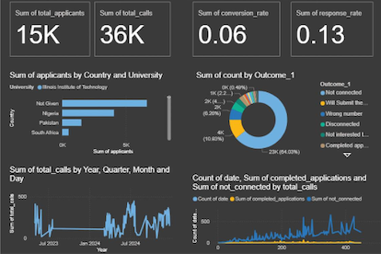
Some of the Findings from the dashboard: Most applicants come from a few key countries (Nigeria, Pakistan, South Africa), with a large number of records missing country info ("Not Given"). Illinois Institute of Technology is a major source university among applicants.
The majority of outreach calls resulted in “Not connected” outcomes, showing challenges in contacting candidates. There is a notable fraction of positive engagement results like “Will Submit the docx” and “Completed application,” indicating some successful conversions.

Slide 12
Suggestions for further analysis, monitoring and testing
Further Analysis
• Predictive Modelling: Develop models to forecast applicant responses based on historical outreach
timing, channel, and demographic factors to prioritize high-potential candidates.
• Segmentation: Perform cluster analysis or segmentation on applicant profiles to identify distinct
groups with varying engagement patterns or needs.
• Channel Effectiveness: Drill deeper into the performance of individual outreach channels to optimize
budget and effort allocation.
Monitoring
• Real-time Dashboard Updates: Automate data refresh for the dashboard to enable near real-time
monitoring of recruitment campaign performance.
• KPI Tracking: Set automated alerts for key metrics like conversion rate drops, high not connected call
rates, or pipeline bottlenecks.
• Data Quality Checks: Regularly monitor missing or inconsistent data metrics to maintain clean and
reliable datasets.

Slide 13
Testing
• A/B Testing: Experiment with different outreach scripts, timings, or follow-up cadences to identify the most effective strategies.
• Channel Trials: Pilot new outreach channels or demographics in controlled tests to assess incremental impact before scaling.
• Contact Data Validation: Test automated methods or services for verifying phone numbers and contact info to reduce “Not connected” calls.

Slide 14

Conclusion
• Data Preparedness: Successfully cleaned and standardized three core datasets (Outreach, Campaign, Applicant), improving reliability for analysis and decision-making.
• Applicant Insights: Majority of applicants originate from a few key countries (Nigeria, Pakistan, South Africa), though a significant portion lack country data, highlighting collection gaps.
• Outreach Effectiveness: Most outreach calls resulted in “Not connected,” revealing a critical barrier to candidate engagement.
• Positive Conversions: Despite challenges, a notable share of candidates progressed with actions such as “Will Submit docx” or completing applications.
• Temporal Patterns: Outreach activity shows strong peaks aligned with campaign cycles but also long lulls, suggesting opportunities for more consistent engagement.
• Strategic Value: Visualizations and KPIs provide a comprehensive dashboard for tracking recruitment health, enabling data-driven adjustments to improve outcomes.
• Actionability: Insights guide future enhancements in outreach strategy, candidate segmentation, and data quality management, ultimately supporting Excelerate’s enrolment growth goals.

Slide 15



Thank You

